Slide 1
Locality Sensitive Hashing
Prepared & Presented By:
Anmol Sureshkumar Panchal( UID-4446829)

Slide 2
Objective
To study LSH and algorithms to improve its performance to process large datasets of information retrieval, data mining, image processing and so on.
Notes:
The key insight behind the technique of LSH is that the hash functions should map adjacent points to the same buckets with higher probability, but map points far from each other to the same buckets with lower probability. The basic idea of LSH is to hash the points from the database to ensure that the probability of collision is much higher for those points that are close to each other than for those that are far apart. LSH is an indexing technique that makes it possible to search efficiently for nearest neighbors amongst large collections of items, where each item is represented by a vector of some fixed dimension. The algorithm is approximate but offers probabilistic guarantees i.e. with the right parameter settings the results will rarely differ from doing a brute force search over your whole collection. The search time will certainly be different though: LSH is useful because the complexity of lookups becomes sublinear in the size of the collection. Now later of this proposal we will see the techniques proposed in the three papers selected to present and will analyze and conduct the comparisons to see which method is more suitable for LSH implementation.

Slide 3
Locality Sensitive Hashing
LSH
Important technique to solve NN and Range Queries.
Its idea is to connect the possibility of collision in the same bucket between points p and point q with their distance.
Notes:
Where d (q, v) denotes the distance between q and v, d1 < d2, h(q) and h(v) represents the hash value of q and v. If hash functions satisfy the two conditions above, we can call it (d1, d2, p1, p2) sensitive. Then we can get one or more hash tables when hashing for data through one or more hash functions of (d1, d2, p1, p2) sensitive, this process is known as Locality-Sensitive hashing.

Slide 4
solution
Method:1- An Improved Algorithm for Locality-Sensitive Hashing [1]
Method:2- Entropy based Locality Sensitive Hashing [2]
Method:3- Frequency based Locality Sensitive Hashing [3]
Method: 4- My implementation using minimum hashing matrix using Jaccard Similarity.

Slide 5
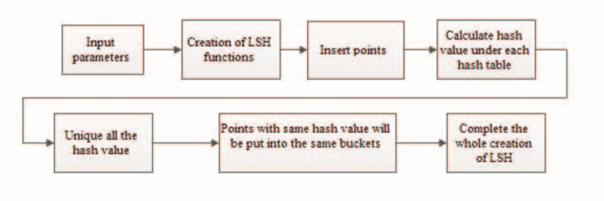
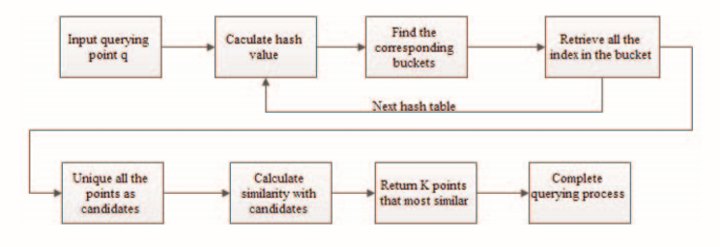
Method 1
Creation model of Locality-Sensitive hashing.
Querying model of Locality-Sensitive hashing.

Slide 6
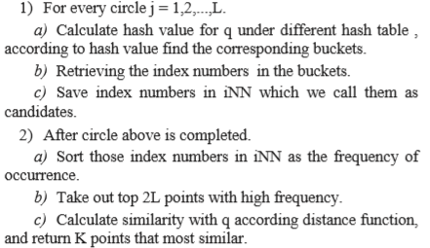
Method 1

Slide 7
Method 2
Most methods are query-directed.
Multiprobe LSH expands the number of query buckets to increase candidates.
Query-adaptive LSH chooses buckets of efficient hash functions by calculating hash values of query points.
Design a set of new hash functions to optimize the mapped values.
Improves the Performance

Slide 8
Method 2
This paper presents a set of new hash functions and explains it in Euclidean space.
For a high-dimensional space Sd and a data set of N points, a is a random vector with the distribution Nd (0,E) and v is a point chosen randomly from Sd, the initial mapped value can be calculated by the following formula: H'a(v)=a·v
The mapped set is {h'1, h'2,…,h'N}. Then they introduced another parameter r, which represents the number of quantization. The mapped value will be quantified to (0, 1, …., r-1).

Slide 9
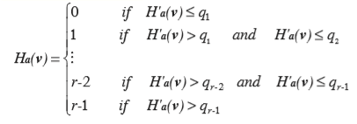
Method 2
First, sort initial mapped values and record 1/r, 2/r,…, (r-1)/r cut-off points as q1,q2,…,qr-1. The number of points will be the same in each mapped region segmented by cutoff points.
Then randomly select k functions from the family H to form g function.
The mapped k-dimensional vector is the final hash value, regarded as a bucket.
Points are mapped to r regions evenly by h-functions. After the projection of a g-function composed of k h-functions, the distribution of points is almost uniform.
Then calculate distribution entropy to evaluate hash functions. The formula is as follows: E(g)=-∑p(N(i))*log(p(N(i)))
Notes:
For a constant number of buckets, uniform collision can result in larger entropy. So, the uniformization of collision probability is to maximize the distribution entropy. In the original LSH, we should create L hash tables. We also choose k*L h-functions, L g-functions, to build L hash tables.

Slide 10
Method 2
To increase the accuracy or for fine tuning you can optimize the parameters K, L and r. The optimization of k, L and r is defined as follows:
Obj: Min(Tg +Tc) St:
1) Tg=kL*tg
2) Tc=(L*N/rk)*tc
3) L=֩(logį)/log(1-prk)֪
Where, tg is the time of computing an h-function and tc is the time of computing distance to a candidate.
We can adjust r and k to minimize (Tg+Tc) and obtain the optimal r, k and L.

Slide 11
Method 2
In the theory of LSH based on p-stable distributions, different mapped regions always have different number of points after the projection of h-functions.
So when it extends to the k-dimensional vector the difference will be greater.
There may be more points near the origin, resulting in uneven distribution. m queries issued in the whole system, (q1,q2,···,qm).
If the mapped vector is far from the zero vector, fewer or no candidates will lead to a lower accuracy.
In this paper author’s used an appropriate mapping method to make k dimensional mapped vectors uniform and the distribution entropy maximum, the number of candidates for each query will be nearly the same.
It could be a good solution to these problems, reducing search time and increasing search accuracy.

Slide 12
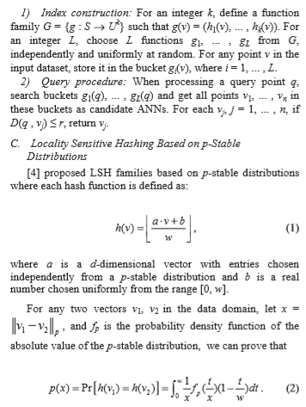
Method 3
Frequency Based Locality Sensitive Hashing scheme is like generic LSH scheme except that it uses a single h(v) as hash function and sets a frequency threshold m to select those points which collide with query point more than m times as candidate ANNs.
Generic LSH works as given: For a fixed parameter w, the probability of collision p(x) decreases monotonically with x, so h(v) belongs to LSH family.
Exact Euclidean LSH (E2LSH) is a popular implementation of LSH based on p-stable distributions using generic LSH scheme which can be used in Euclidean space, and they just used it in their paper to compare with their method presented in this paper.

Slide 13
Method 3
Frequency based LSH works as follows:
1) Index construction: For an integer L (L > 1), choose L functions h1, ... , hL from H (based on p-stable distributions), independently and uniformly at random. For any point v in the input dataset, store it in the bucket hi(v), where i = 1, ... , L.
2) Query procedure: For a query point q, search buckets h1(q), ... , hL(q) and get all points v1, ... , vn which appear no less than m times in these buckets as candidate ANNs. For each vj, j = 1, ... , n, if D(q , vj)  r, return vj.

Slide 14
Pro’s & con’s
In paper 1 they discussed mainly comparing and improving the method with LSH based on hamming distance and LSH based on Euclidean distance (E2LSH).
Their experiments were able to show that the improved algorithm has a higher accuracy rate and recall rate than LSH which based on hamming distance.
In second paper, to get better performance than that of first paper by using multi-probe or query-adaptive strategy for their proposed new hash functions. The paper also proposed a method to automatically optimize parameters, but the estimation of parameter pr may be inaccurate sometimes, leading to parameter tuning failure.

Slide 15
Pro’s & con’s
In the third paper which is based on frequency based LSH (FBLSH) which needs fewer hash tables and comparisons than E2LSH with the same accuracy.
Besides, FBLSH needs only about 4nL bytes memory while E2LSH needs about 12nL bytes, where n is the size of dataset. That’s why FBLSH can reduce the space cost effectively.
And also FBLSH consumes much less query time than E2LSH. For large datasets, the frequency counting time becomes longer and FBLSH has similar query time with E2LSH. So far we can conclude that the third paper’s proposed approach is more accurate and faster than other two methods.

Slide 16
My Method of lsh implementation

Slide 17
CONCEPT
Sentence A: "The dog is brown“
Sentence B: "The dog is happy"
words: the | dog | is | brown | happy | sunshine
A: 1 | 1 | 1 | 1 | 0 | 0
B: 1 | 1 | 1 | 0 | 1 | 0
This can be formulated as a set problem, and the two ordered sets can be compared:
Sentence A = [1, 1, 1, 1, 0, 0]
Sentence B = [1, 1, 1, 0, 1, 0]
Each sentence has a bit in the first 3 columns. And 5 columns have a bit in at least one of the sets. So we’ll give these two sentences a similarity score of 3/5 or 0.6. The formal name for this is Jaccard Similarity.
How similar are the two sentences?
How can the similarity be scored?
Notes:
For each sentence and each column, a 1 indicates a word was present and a 0 indicates the word was not present. Note that the word "sunshine" is added to the matrix, and since neither sentence contain that word, both have a 0 in that column. This is added to the example to help illustrate how those are dropped later as a part of the similarity measurement.

Slide 18
WORKING
Here we used LSH to find near duplicates for documents. This is done by splitting the Minimum Hash key matrix into bands and then hashing each band. Any documents where a band is hashed to the same bucket are considered near duplicates.
Creates a new LSH object.
Minimum Hash matrix where rows are documents, columns are the hash functions.
Array of document names are stored in collection.
Number of bands is used to split minimum Hash matrix.
Then it Computes a list of near duplicate documents. Near duplicate documents are documents where at least one of the bands hash to the same bucket.

Slide 19
Working
We use a Container object to store the band number and hash value. In LSH, the MinHash matrix is split into B bands: 1,2,...,B and each band is R-rows. The R-rows in a band are hashed to get a hash value for that band. This object stores the band Number and the hash value for that band.
Then Return the hash code of container for mapping those hash keys and bands.
Then compare equality against other Pair containers. Return True if band and hash values are equal, otherwise false.

Slide 20
implementation
Generates minimum hash for a collection of documents.
The permutations are represented by randomized hash functions: ax + b % p.
p is a prime such that p >= n where n is the number of terms in the collection.
a and b are chosen uniformly at random from {1,2,...,p-1}.
Minimum Hash matrix generated will by M * N. M = number documents and N = number of permutations.
Each element in Minimum Hash matrix will be the MinHash value of the document.
MinHash matrix has documents as rows and permutations as columns.
There is minimal preprocessing.

Slide 21
implementation
Calculates the exact jaccard similarity between two documents.
Compare: first document, second document……. N documents
Return Jaccard similarity of these documents.
Computes the MinHash signature for all documents in the collection.
Computes the approximate jaccard simularity by using the MinHash signatures.
Gives the total number of unique terms in the collection of documents after basic preprocessing.
User must specify <folder> with collection of documents, <number of permutations> for use with MinHash matrix, and the <error parameter>.
This will print out the number of document pairs where the approximate jaccard similarity and exact jaccard similarity differ by more than the <error parameter>.
Hash keys of similar objects are more likely to be equal

Slide 22
implementation
Calculates the approximate jaccard similarity and exact jaccard similarity for all pairs of documents and then counts the number of times the difference between the exact and approximate jaccard similarities differs by more than the user specified error parameter.
Prints time it takes to calculate exact jaccard similarity and time it takes to calculate approximate jaccard similarity.
Calculates the number of false positives that were hashed together into the same bucket in LSH.
User specifies <folder> with collection of documents, <number of permutations> for MinHash Matrix, <number of bands> for LSH, <similarity threshold> and <file> to find near duplicates for.
Afterwards this will print out the number of false positives; documents that were hashed together in the same bucket for LSH.
Incorporation of threshold is nothing but entropy/frequency.

Slide 23
Benefits over other methods
Jaccard similarity has greater accuracy and generates less erroneous results for larger datasets.
It has less response time than first two methods and no significant difference with the third method.
It is relative easy to implement.
It has all benefits of Frequency based LSH.

Slide 24
references
[1Wu, T., & Miao, Z. (2016). An improved feature image matching algorithm based on Locality-Sensitive Hashing. 2016 IEEE 13th International Conference on Signal Processing (ICSP). doi:10.1109/icsp.2016.7877927
[2] Wang, Q., Guo, Z., Liu, G., & Guo, J. (2012). Entropy based locality sensitive hashing. 2012 IEEE International Conference on Acoustics, Speech and Signal Processing (ICASSP). doi:10.1109/icassp.2012.6288065
[3] Ling, K., & Wu, G. (2011). Frequency Based Locality Sensitive Hashing. 2011 International Conference on Multimedia Technology. doi:10.1109/icmt.2011.6002015a
https://github.com/gamboviol/lsh

Slide 25
THANK YOU
?

